Slide 1

Methods used for forecasting in volatile & unstable markets, ARIMA – LSTM comparison
RESEARCH METHODOLOGY – PART A
Economic Physics - Financial Forecasts
First semester 2021-22
By Maroulis Adamadios
Professor: Theodoros Karakasidis

Slide 2
Introduction
The main goal of an investor
Methods used characterized traditional, advanced
Improvement of portfolio / analysis
Machine learning and deep learning propositions, ARIMA – LSTM examination - comparison
First case examination in depth, operation, performance
Second, third case different data sets for better understanding, conclusions

Slide 3
Research questions
Does deep learning approaches perform better than more traditional ones?
Does those approaches have higher efficiency?
Evidence to prove the hypothesis?
Similar conclusions?

Slide 4
ARIMA and XGBoost-LSTM in stock price forecasting
Forex data for ARIMA
Forex data for XGBoost, LSTM
01/01/2008 – 03/19/2018
709,314 total observations
59,094 subset observations for ARIMA
Sub dataset split 70% training - 30% testing
60-minute price
01/01/2008 – 03/19/2018
709,314 total observations
709,314 observations for LSTM
Sub dataset split 60% training - 20% validation - 20% testing
XGBoost used for selection in feature importance based on the F-score value
Notes:
The validation test set assesses the ability of the neural network to predict based on new conditions that were not part of the training set.

Slide 5
ARIMA AND LSTM IN FORECASTING TIME SERIES
Data
Observations
Nikkei 225 index (N225)
NASDAQ (IXIC)
Hang Seng Index (HIS)
S&P 500 (GSPC)
Dow Jones (DJ) monthly
Dow Jones (DJ) weekly
Medical Care Commodities (MC)
Housing (HO)
Trade-weighted U.S dollar index (EX)
Food & Beverages (FB)
M1 Money Stock (MS)
Transportation (TR)
Notes:
We can find the data distribution in more detail in the article

Slide 6
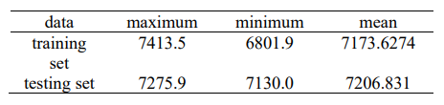
ARIMA AND LSTM IN BITCOIN PRICE PREDICTION
Bitcoin data
Dataset attributes
10000 observations
Split into 80% training – 20% testing
Use price of each 5 seconds for training model
For ARIMA stationarity and seasonality were checked because of high frequency
For forecasting the refined data set contains 733 points in training and 100 points in testing after data processing ARIMA
The model is trained 100 epochs with 10 pieces of data in each round for LSTM
Notes:
The author is not referred to the exact sample that was used

Slide 7
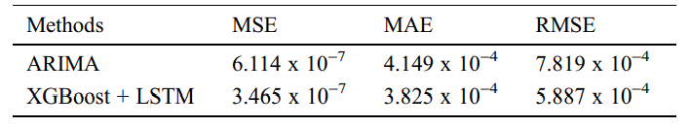
Findings first case
Prediction results of the ARIMA model on the test dataset
Prediction results of the XGBoost and LSTM model on the test dataset
Importance of the model, proving great results in forecasting efficiency. Lacks the memory privilege, makes it less accurate in bigger periods of time.
Performance comparison of the proposed approach and ARIMA on a Forex dataset
High forecasting efficiency especially when compared to the ARIMA model, achieved the best accuracy, promising for long-term predictions because of the selection in important and relevant information advantage

Slide 8
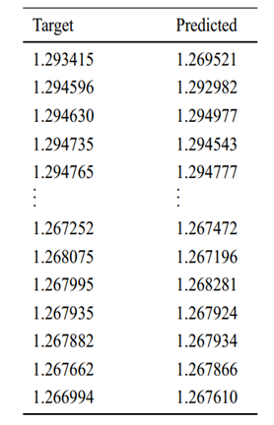
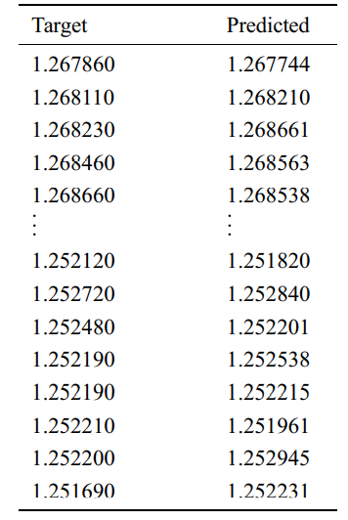
Findings first case
Prediction results of the ARIMA model on the test dataset
Prediction results of the XGBoost and LSTM model on the test dataset

Slide 9
Findings second case
Amazing results for LSTM compared to ARIMA
Outperformed in reduction error rate for over 80%
Average of 87.445 reductions in error rates by LSTM.
Data showed reduction of 84.394 in RMSE
Average estimation value of 5.999 in ARIMA and 0.936 in LSTM.
The data showed that the LSTM-based algorithm in comparison to the ARIMA algorithm made almost 85% better prediction on average.

Slide 10
Findings third case
Both models proved efficient
LSTM model much more time consumer compared to the ARIMA model
LSTM model much more efficient in predictions, precision rate.
ARIMA performs well in short term
As the time grows, precision rate decrease
LSTM predicts better when less previous data under consideration
Can handle better long periods of time (high precision rate)

Slide 11
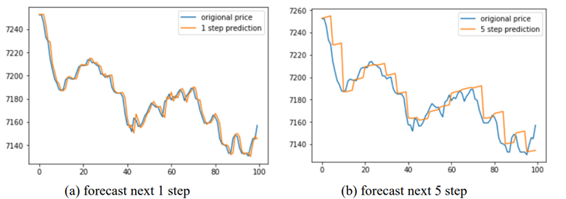
Findings third case
Forecast based on ARIMA
Notes:
Forecast based on ARIMA

Slide 12
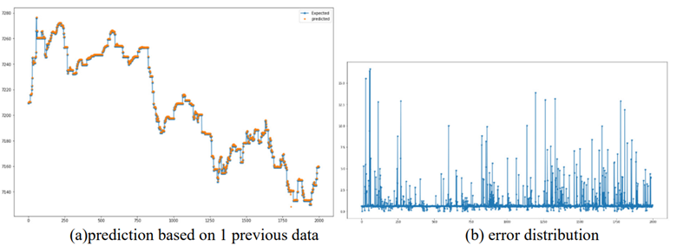
Findings third case
LSTM prediction result

Slide 13
Conclusion
First case: XGBoost was used as the feature-selection method, models compared in terms of performance in SPF. Results showed that DL method outperformed the ML method
LSTM picks the most useful information
ARIMA lacks memory privilege
Second case: evidence that the LSTM model outperformed the ARIMA model by over 80% reduction in error rates and made almost 85% better prediction on average.
Third case: Both models performed great, high efficiency
LSTM more efficient as the time grows , time-consuming
ARIMA high efficiency in short period of time

Slide 14
Ευχαριστώ για το χρόνο σας!! Μαρούλης Αδαμάντιος
Τhis paper supports the benefits of applying deep learning, although more research is needed to conclude that hypothesis as there are several other models that perform better when compared to deep learning approaches in many cases!!

